Slide 1
Public Group Meeting (9/11/24)
Somdeepa Das

Slide 2
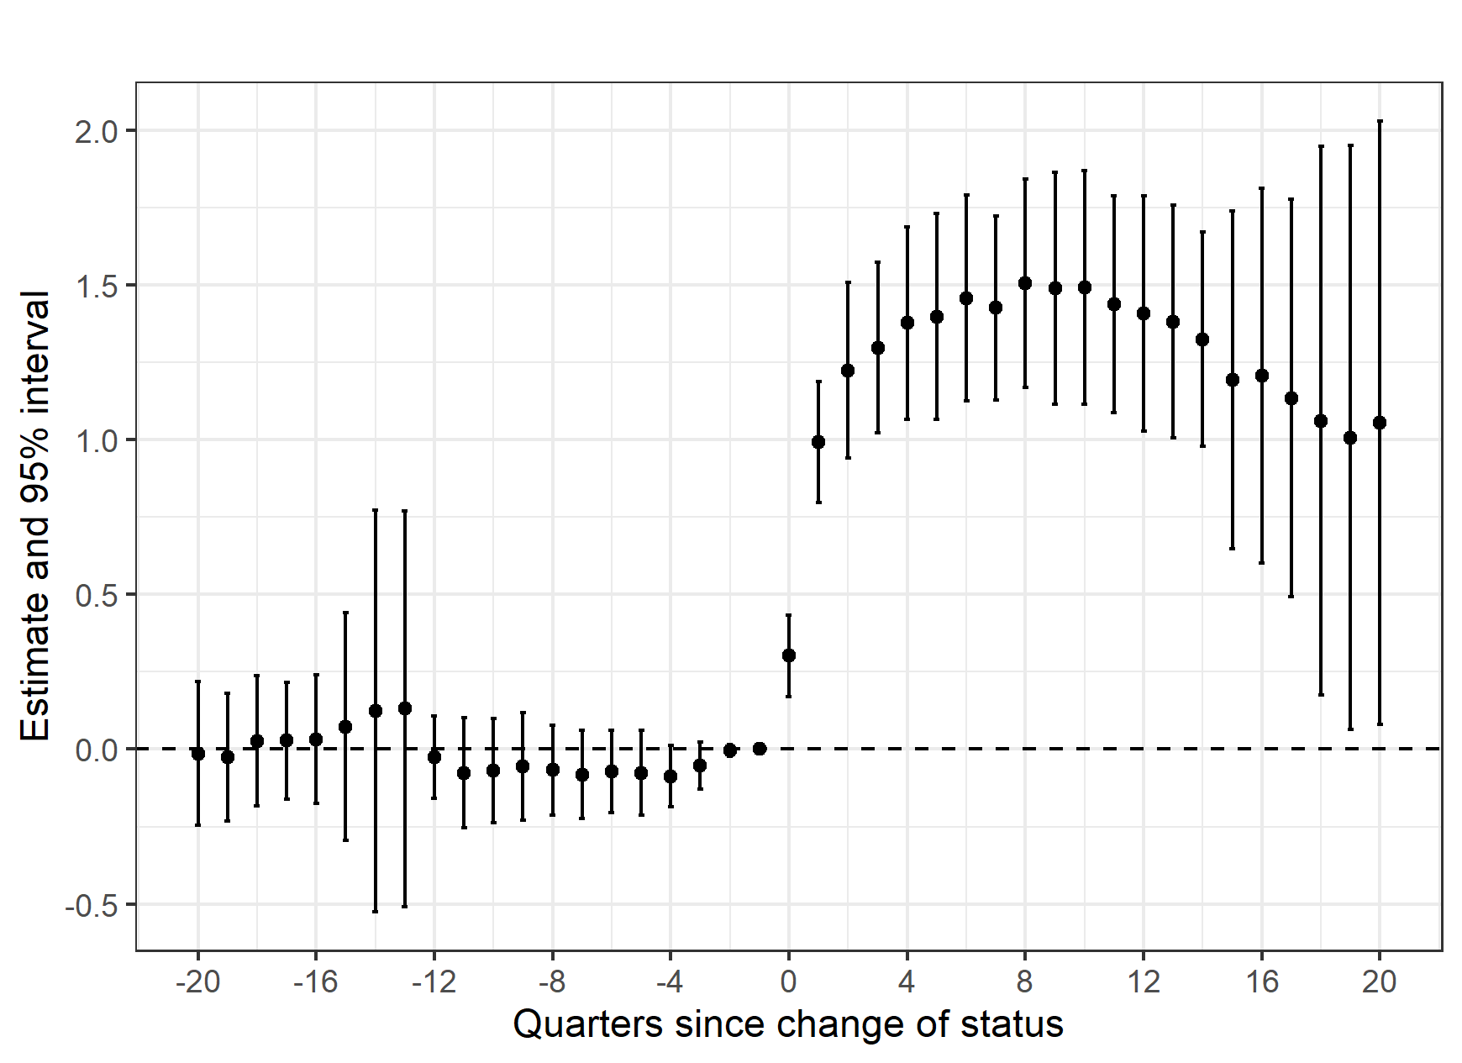
Effect of Dry->Wet transitions on liquor licenses
I was using a event study of only treated cities to see how change in status from dry to wet affected the number of liquor licenses
I check the same effect by using the vote shares in these elections – crossing the vote share cutoff of 50% means that the city transitioned from dry - wet

Slide 3
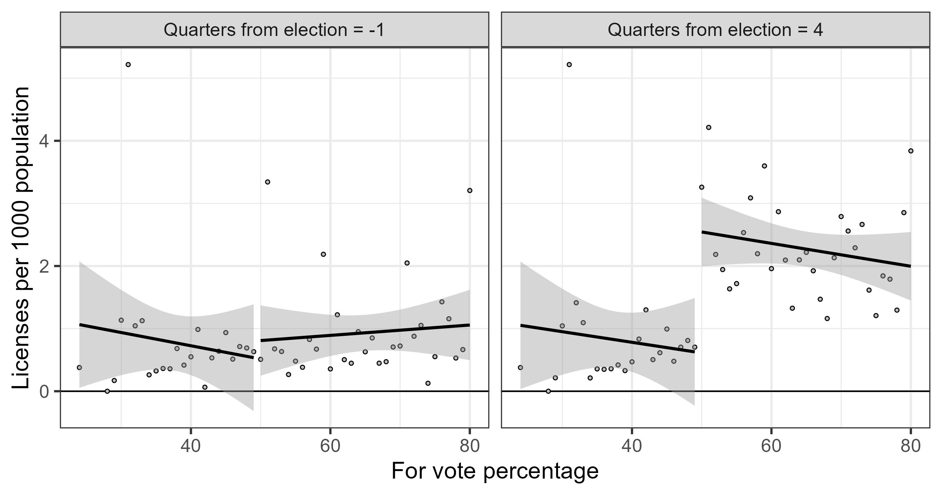
Alcohol licenses by vote share

Slide 4
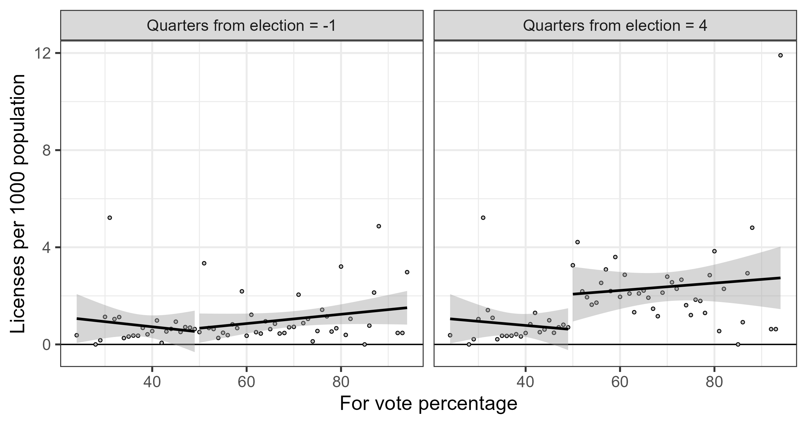
Alcohol licenses by vote share (full sample)

Slide 5
New dataset – Liquor receipts in Texas
Recently acquired data on liquor receipts (sales) from 1993-2007 (post 2007 data was present on open data portal
Administrative data on on-premise alcohol sales by license and month, separated into wine, beer and liquor sales
This data is collected because bars/restaurants have to pay taxes
Prior to 2014, 14% tax on retailers
From 2014 – 6.7% on retailers, 8.25% on consumers

Slide 7
